Slide 1
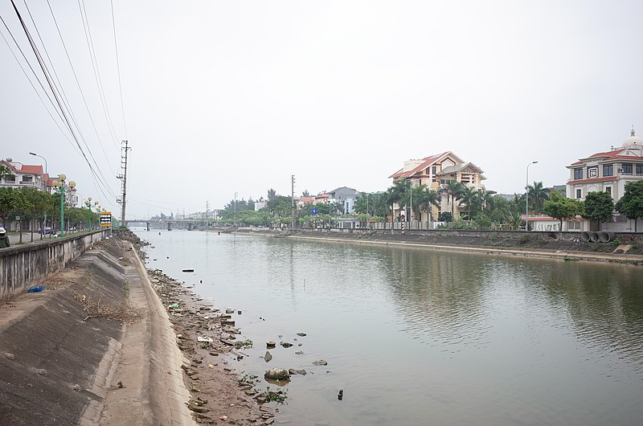
BHH Waste Management, the serious game
Current state: 4/5/2022

Slide 2
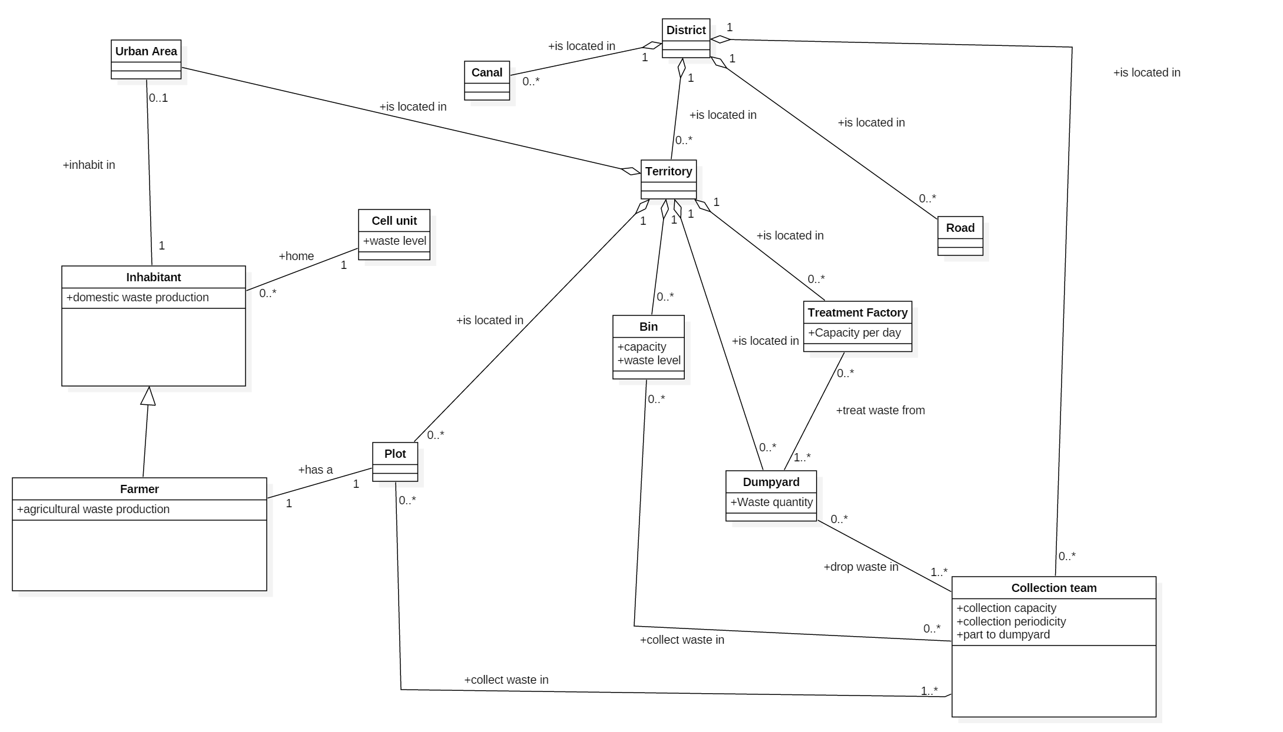
Current model

Slide 3
The game
4 players play successively
A player plays the role of the local manager of one of the territory
1 round for all players = 1 year,
alternating between players' rounds and calculation of indicators
A player can do different actions on his territory (build bins, a waste treatment plant, ....)
Each action costs money taken from the global budget (one budget for all players).
Idea: use cards for the choice of actions to facilitate the manipulation of the actions and the discussion.
The indicators will be projected on a central table (or on a wall?)

